Slide 1
Pigment molecule interacts with sunlight. The energy breaks the bonds in water molecules. Oxygen is “breathed out” by plants as waste and the other products are used to help plants make their own food (ATP and glucose).
2 H₂O → O₂ + 4 H⁺ + 4e⁻
Question: Can light of any energy catalyze this reaction?
Notes:
This is the simple cartoon I use to introduce photosynthesis to students.

Slide 2
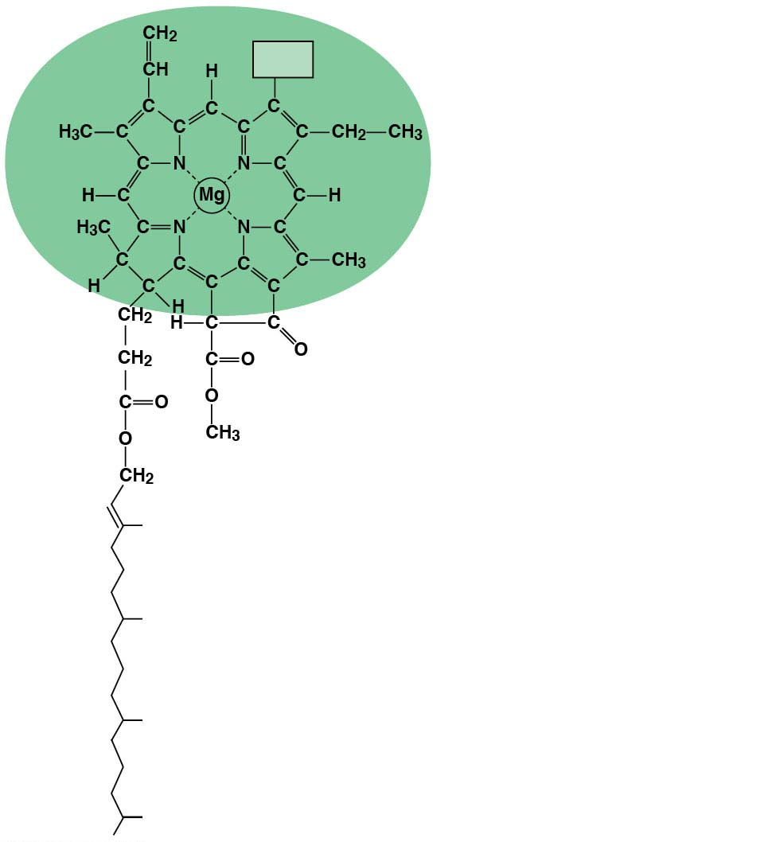
CH₃
Notes:
Structure of chlorophyll molecules in chloroplasts of plants. I don’t really talk about this much but it’s nice to have on hand in case a student wants to know how it works.

